Slide 1


Health disease prediction
Bindu Pravardhan
Vaibhav Sai
Pradeep
Yedukondalu
Under the Guidance of Mahendra

Slide 2

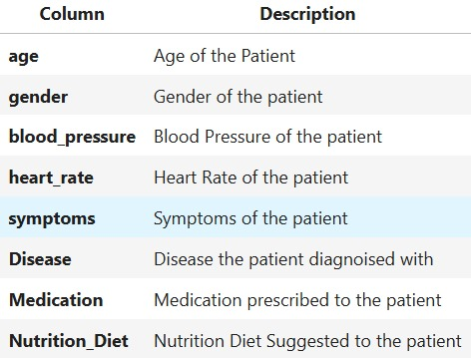
Business and goal
Business : Medical
Goal : Predicting Disease, Medication and Diet
Skill : Machine Learning Model Building
F A C T O R S

Slide 3

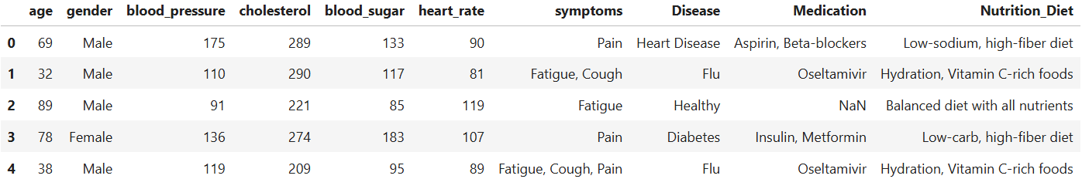
Data collection
S O U R C E
The Data has been collected from the Git.
D A T A

Slide 4


Slide 5
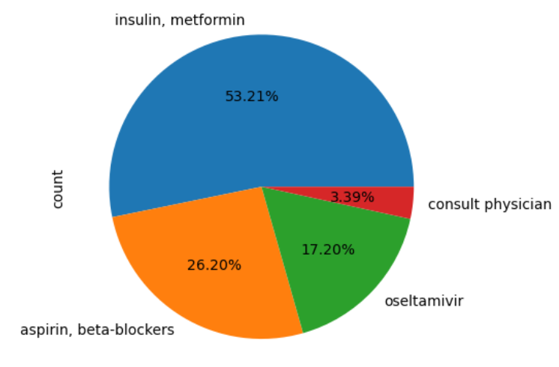
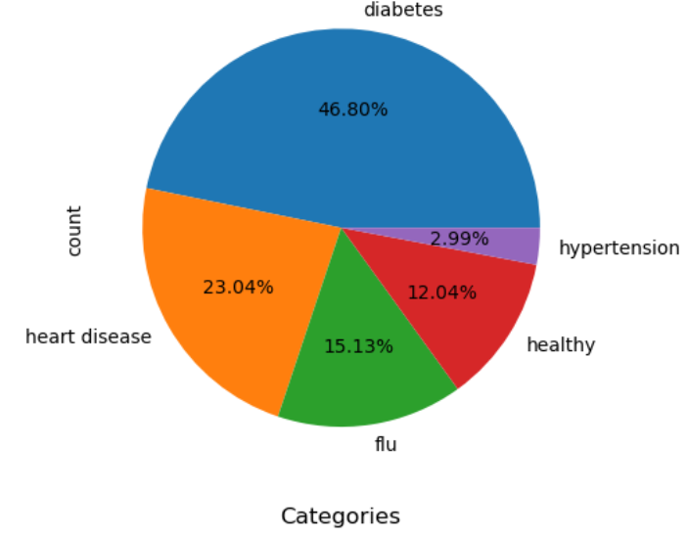
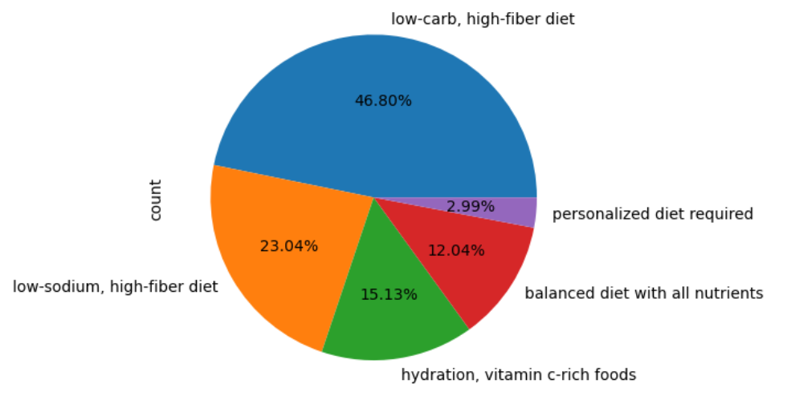
UNI-VARIATE ANALYSIS

Slide 6
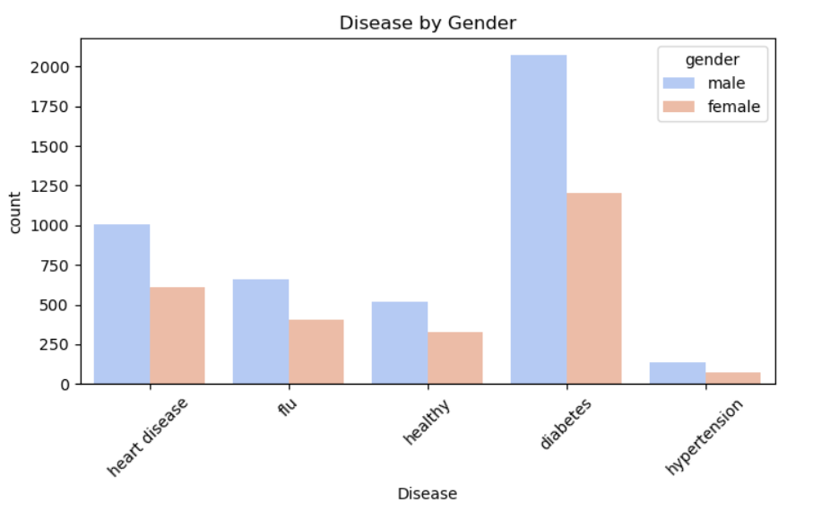
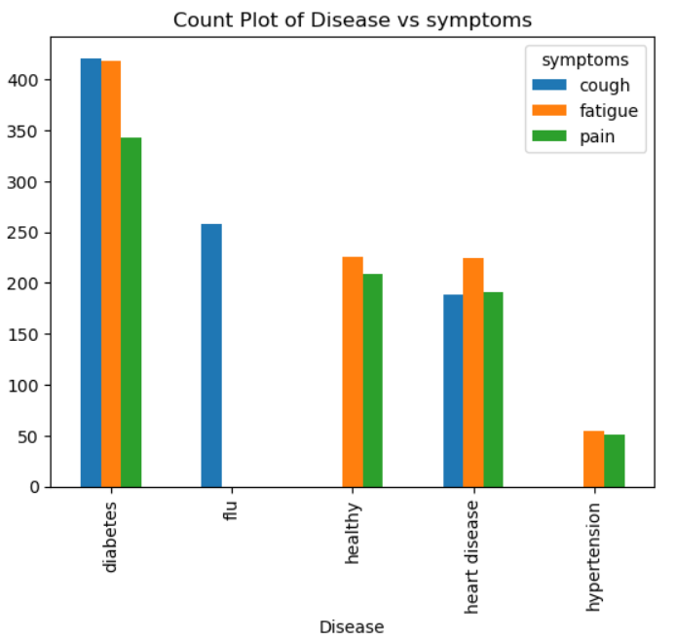
BI-VARIATE ANALYSIS

Slide 7
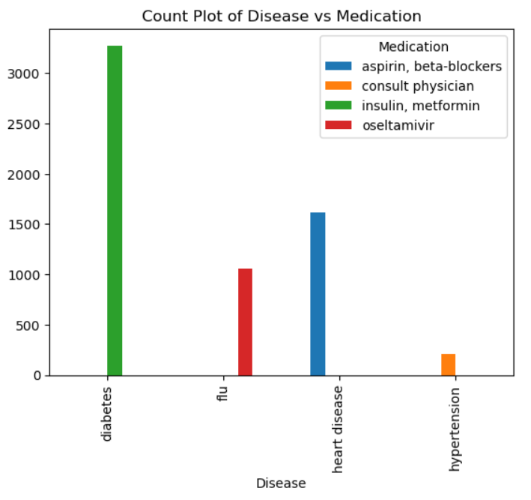
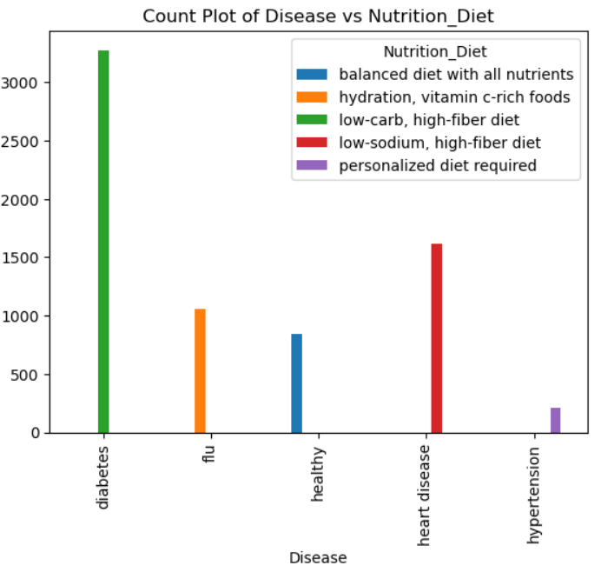

Slide 8
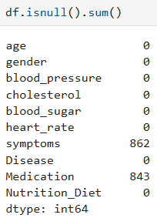
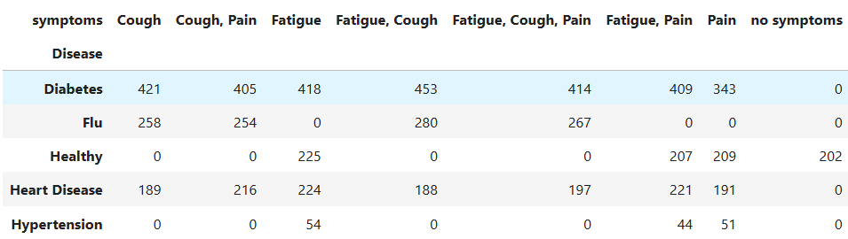
NULL VALUES HANDLING

Slide 9
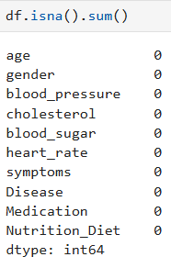
AFTER HANDLING

Slide 10

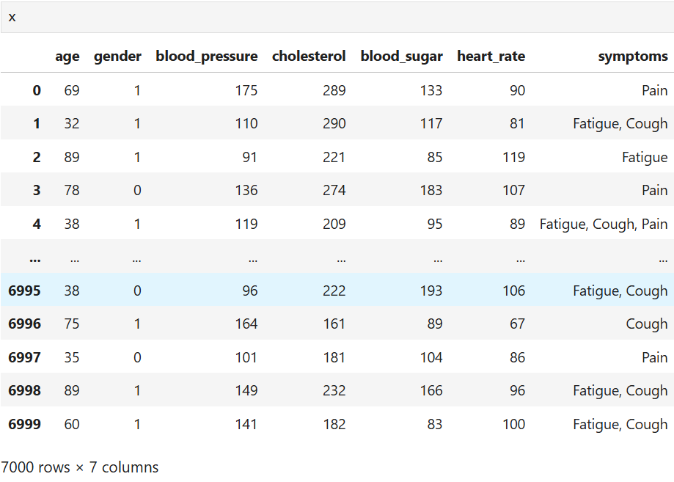
X and Y Selection

Slide 11
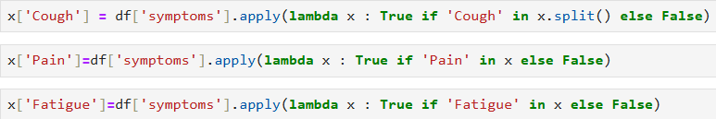
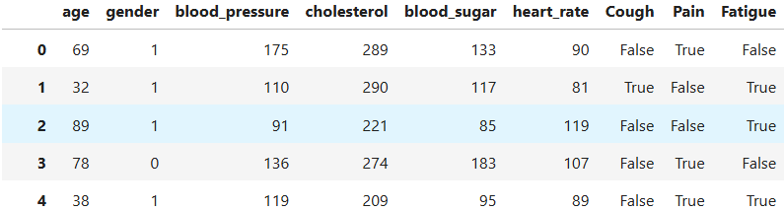
Feature Engineering of x for y

Slide 12
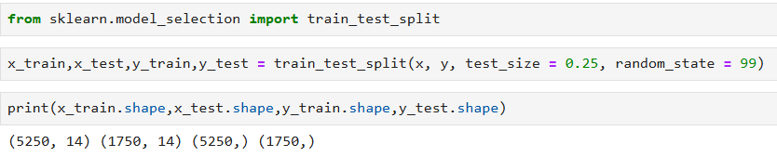
TRAIN, TEST AND SPLIT
Train Data – 75% of the data with 5250 rows.
Test Data – 25% of the data with 1750 rows.

Slide 13
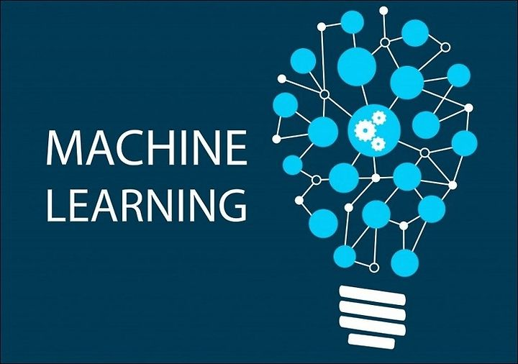
MODELS

Slide 14
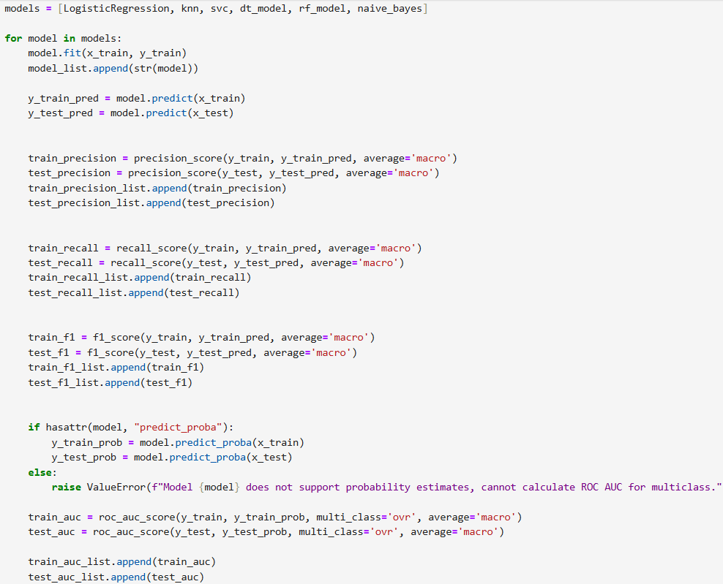
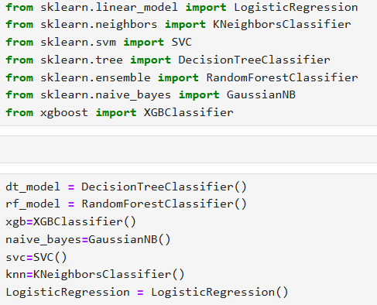
DISEASE PREDICTION

Slide 15
MEDICATION PREDICTION

Slide 16
DIET PREDICTION

Slide 17


Slide 18
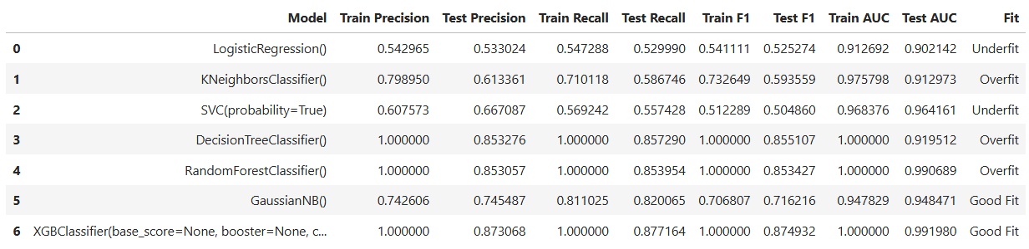
Disease Model Evaluation
Best Model: XG Boost

Slide 19
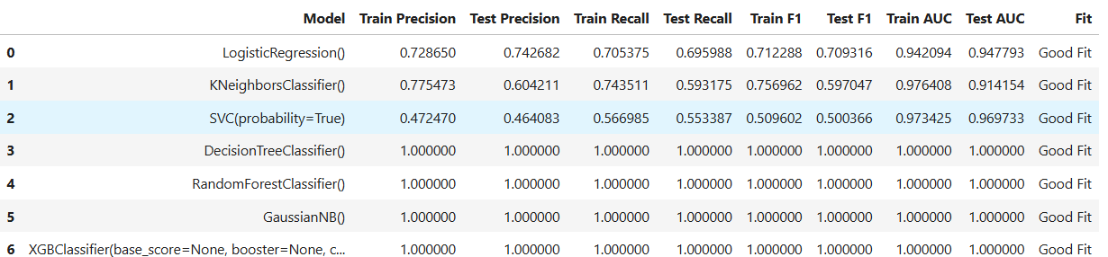
MEDICATION Model Evaluation
Best Model: XG Boost

Slide 20
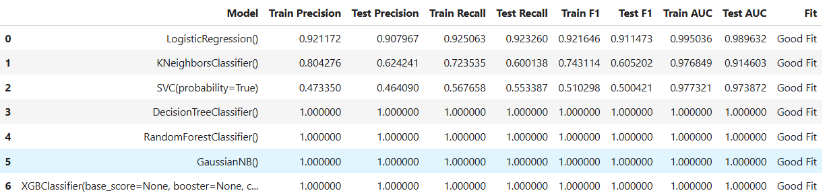
DIET Model Evaluation
Best Model: XG Boost

Slide 21
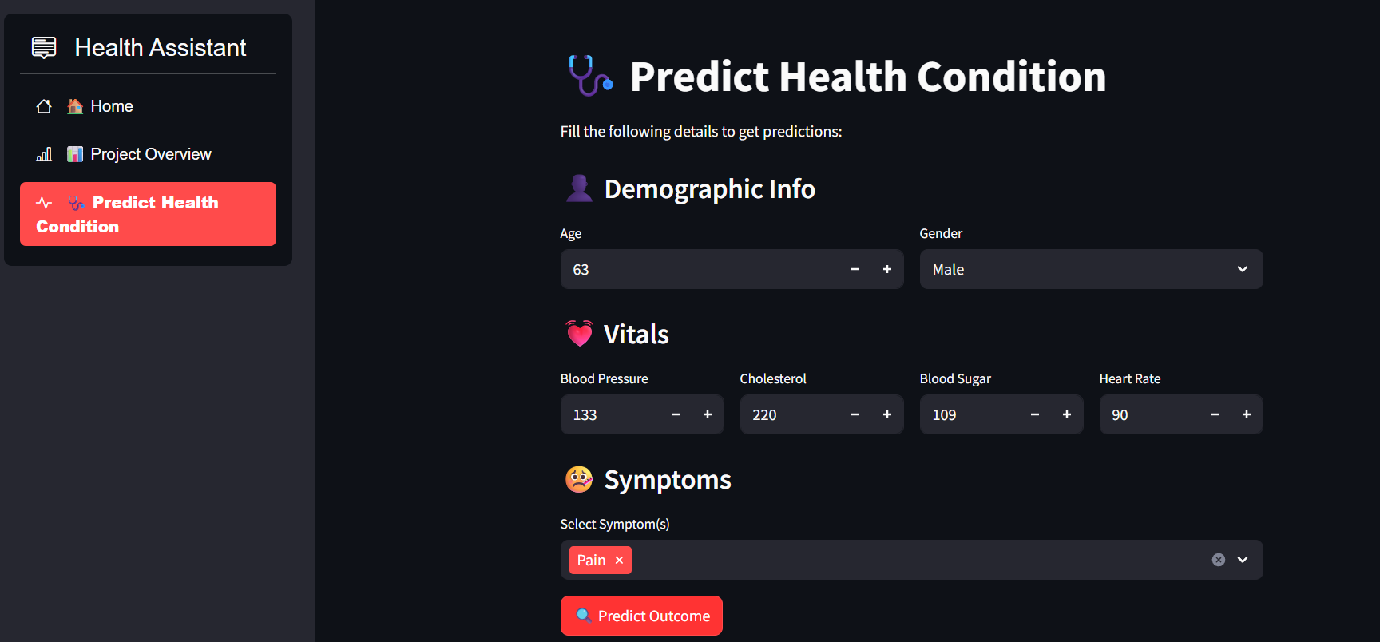
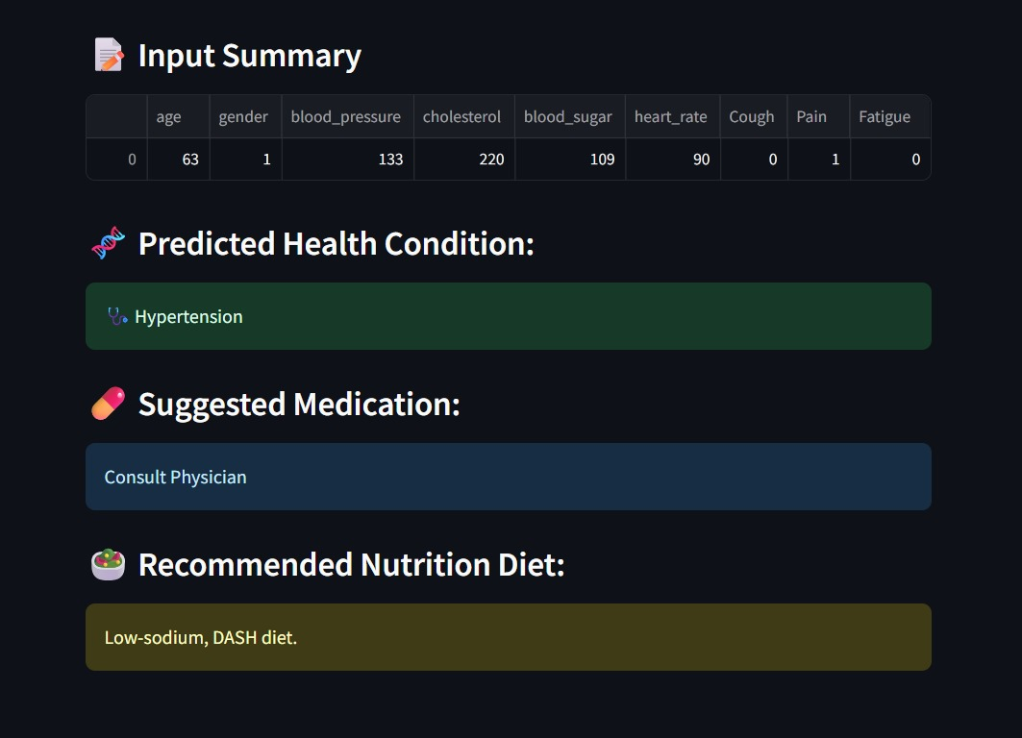
Real time prediction

Slide 22

THANK YOU

